Slide 1

Methodical Mycology
Increased Safety through
Machine Learning
Group 3: Chathu, Curtis, Tammy

Slide 2

AGENDA
Introduction
Dataset
Descriptive Analysis
Feature Selection
Design of Experiments
Results
Conclusion

Slide 3
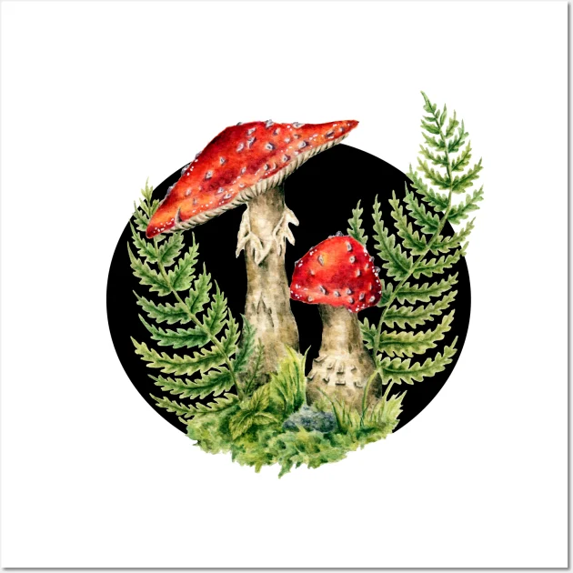
Introduction
Safe mushroom is important to human diet, nutrition, medicine and biodiversity
2K out of 45K species are edible
Mushroom poisoning is a global problem
Researchers have been investigating mushroom classification
Random Forest, Decision Tree, Neural Network, Support Vector Machines show high accuracy in past research

Slide 4
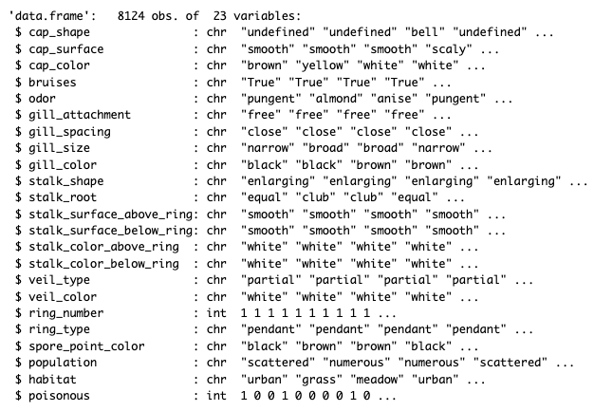
Dataset
Acquired from Kaggle "Mushroom Classification"
Description of Data
Type of Problem
Goal for Dataset

Slide 5
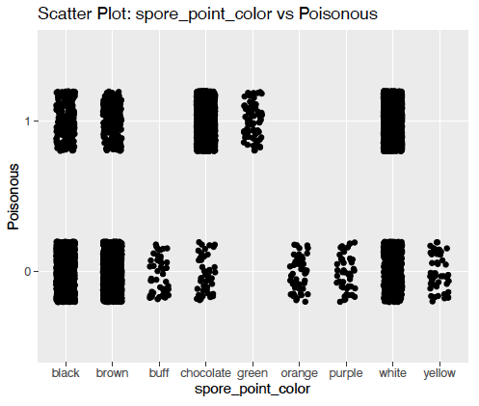
Descriptive Analysis
117
Dummy Variables
37
Remove <10% Correlation
15
Ridge Regression and Chi-square
Data Visualization eg ggplots
Remove multicollinearity
Apply ANOVA and Linear Model
6

Slide 6
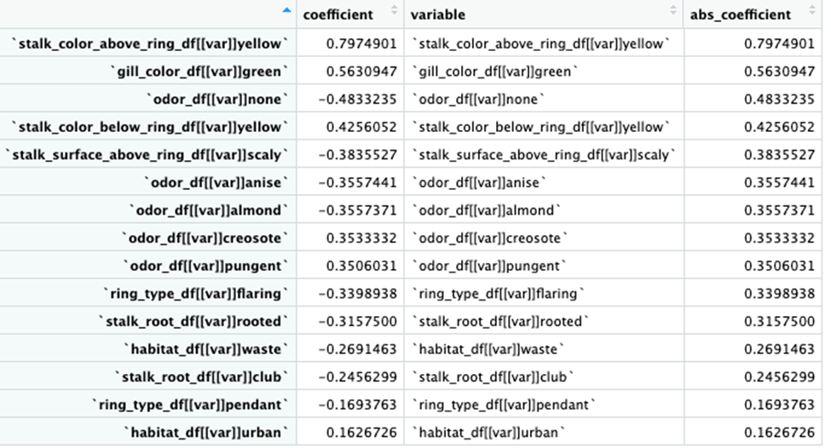
Plot: Ridge Regression Results

Slide 7
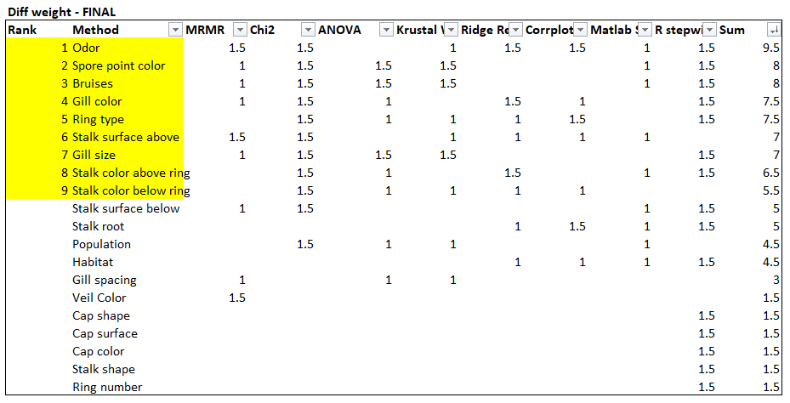
Feature Selection
Prior to MATLAB
MATLAB
Features Present in Literature Review
Combining Approaches to Rank Features
Plot: Feature Ranking

Slide 8
Design of Experiments
Run # | CV | TEST SIZE | # OF FEATURES
Run 1 | 4 | 10 | 3
Run 2 | 4 | 10 | 6
Run 3 | 4 | 10 | 9
Run 4 | 4 | 15 | 3
Run 5 | 4 | 15 | 6
Run 6 | 4 | 15 | 9
Run 7 | 4 | 20 | 3
Run 8 | 4 | 20 | 6
Run 9 | 4 | 20 | 9
Run 10 | 6 | 10 | 3
Run 11 | 6 | 10 | 6
Run 12 | 6 | 10 | 9
Run 13 | 6 | 15 | 3
Run 14 | 6 | 15 | 6
Run 15 | 6 | 15 | 9
Run 16 | 6 | 20 | 3
Run 17 | 6 | 20 | 6
Run 18 | 6 | 20 | 9
Run 19 | 8 | 10 | 3
Run 20 | 8 | 10 | 6
Run 21 | 8 | 10 | 9
Run 22 | 8 | 15 | 3
Run 23 | 8 | 15 | 6
Run 24 | 8 | 15 | 9
Run 25 | 8 | 20 | 3
Run 26 | 8 | 20 | 6
Run 27 | 8 | 20 | 9
Purpose of DOE
Identify Top Criteria
Accuracy, False Negative Rate, F2, Balanced Accuracy
Determine Run Parameters
Cross Validation (4, 6, 8)
Features (3, 6, 9)
Test size (10, 15, 20)
27 Runs with 11 ML Methods

Slide 9
RUN 1 | FEATURES |  |  | MATLAB (TESTING CONFUSION MATRIX) |  |  |  |  |  | COMPUTED CRITERIA
Method | # of Cross Validation | Test Data Size () | # of Features | Time (sec) | Hyperparameter/min classification error | TP (Top Left) | TN (Bot Right) | FP (Bot Left) | FN (Top Right) | Accuracy % | TPR % | TNR % | PPV % | NPV % | FNR % | FPR % | FDR % | FOR % | PT % | CSI % | Prevalence % | BA % | F1 % | MCC % | FM % | BM % | MK % | F2 % | F.5 %
Optimizeable Tree | 4 | 10 | 3 | 17.898 | Ginni/0.0054703 | 421 | 383 | 8 | 0 | 99.01 | 100.00 | 97.95 | 98.14 | 100.00 | 0.00 | 2.05 | 1.86 | 0.00 | 12.51 | 98.14 | 99.01 | 98.98 | 99.06 | 98.04 | 99.06 | 97.95 | 98.14 | 99.62 | 98.50
Binary GLM Logisitic Regression | 4 | 10 | 3 | 6.2386 |  | 421 | 383 | 8 | 0 | 99.01 | 100.00 | 97.95 | 98.14 | 100.00 | 0.00 | 2.05 | 1.86 | 0.00 | 12.51 | 98.14 | 99.01 | 98.98 | 99.06 | 98.04 | 99.06 | 97.95 | 98.14 | 99.62 | 98.50
Optimizable Naïve Bayes | 4 | 10 | 3 | 17.084 | Gaussian/0.020512 | 418 | 376 | 15 | 3 | 97.78 | 99.29 | 96.16 | 96.54 | 99.21 | 0.71 | 3.84 | 3.46 | 0.79 | 16.43 | 95.87 | 97.78 | 97.73 | 97.89 | 95.60 | 97.90 | 95.45 | 95.74 | 98.72 | 97.07
Optimizable SVM | 4 | 10 | 3 | 45.89 | Cubic/0.0054703 | 421 | 383 | 8 | 0 | 99.01 | 100.00 | 97.95 | 98.14 | 100.00 | 0.00 | 2.05 | 1.86 | 0.00 | 12.51 | 98.14 | 99.01 | 98.98 | 99.06 | 98.04 | 99.06 | 97.95 | 98.14 | 99.62 | 98.50
Efficient Logistic Regression | 4 | 10 | 3 | 7.7652 |  | 421 | 383 | 8 | 0 | 99.01 | 100.00 | 97.95 | 98.14 | 100.00 | 0.00 | 2.05 | 1.86 | 0.00 | 12.51 | 98.14 | 99.01 | 98.98 | 99.06 | 98.04 | 99.06 | 97.95 | 98.14 | 99.62 | 98.50
Efficient Linear SVM | 4 | 10 | 3 | 6.9636 |  | 421 | 383 | 8 | 0 | 99.01 | 100.00 | 97.95 | 98.14 | 100.00 | 0.00 | 2.05 | 1.86 | 0.00 | 12.51 | 98.14 | 99.01 | 98.98 | 99.06 | 98.04 | 99.06 | 97.95 | 98.14 | 99.62 | 98.50
Optimizable KNN | 4 | 10 | 3 | 56.463 | City block/0.0054703 | 421 | 383 | 8 | 0 | 99.01 | 100.00 | 97.95 | 98.14 | 100.00 | 0.00 | 2.05 | 1.86 | 0.00 | 12.51 | 98.14 | 99.01 | 98.98 | 99.06 | 98.04 | 99.06 | 97.95 | 98.14 | 99.62 | 98.50
SVM Kernel | 4 | 10 | 3 | 11.548 |  | 421 | 383 | 8 | 0 | 99.01 | 100.00 | 97.95 | 98.14 | 100.00 | 0.00 | 2.05 | 1.86 | 0.00 | 12.51 | 98.14 | 99.01 | 98.98 | 99.06 | 98.04 | 99.06 | 97.95 | 98.14 | 99.62 | 98.50
Logistic Regression Kernel | 4 | 10 | 3 | 4.9913 |  | 421 | 383 | 8 | 0 | 99.01 | 100.00 | 97.95 | 98.14 | 100.00 | 0.00 | 2.05 | 1.86 | 0.00 | 12.51 | 98.14 | 99.01 | 98.98 | 99.06 | 98.04 | 99.06 | 97.95 | 98.14 | 99.62 | 98.50
Optimizable Ensemble | 4 | 10 | 3 | 148.4 | Bag/494/3018/0.0054703 | 421 | 383 | 8 | 0 | 99.01 | 100.00 | 97.95 | 98.14 | 100.00 | 0.00 | 2.05 | 1.86 | 0.00 | 12.51 | 98.14 | 99.01 | 98.98 | 99.06 | 98.04 | 99.06 | 97.95 | 98.14 | 99.62 | 98.50
Optimizable Neural Network | 4 | 10 | 3 | 172.16 | 1/Than/45/0.0054703 | 421 | 383 | 8 | 0 | 99.01 | 100.00 | 97.95 | 98.14 | 100.00 | 0.00 | 2.05 | 1.86 | 0.00 | 12.51 | 98.14 | 99.01 | 98.98 | 99.06 | 98.04 | 99.06 | 97.95 | 98.14 | 99.62 | 98.50

Slide 10
3 SETS MEDIAN ACCURACY RESULT COMPARISON

Slide 11
SET 1 (RUN 1 TO RUN 9) ACCURACY (%)
Parameters (# of CV/Test Size %/# of Features) | 4/10%/3 | 4/10%/6 | 4/10%/9 | 4/15%/3 | 4/15%/6 | 4/15%/9 | 4/20%/3 | 4/20%/6 | 4/20%/9
Algorithms | RUN 1 | RUN 2 | RUN 3 | RUN 4 | RUN 5^{MAX} | RUN 6 | RUN 7 | RUN 8^{MAX} | RUN 9
Optimizable Tree | 99.01 | 99.75 | 100.00 | 99.34 | 100.00 | 100.00 | 99.45 | 100.00 | 100.00
Binary GLM Logistic Regression | 99.01 | 99.75 | 100.00 | 99.34 | 100.00 | 100.00 | 99.45 | 100.00 | 100.00
Optimizable Naïve Bayes | 97.78 | 94.46 | 96.92 | 98.28 | 94.17 | 95.57 | 98.21 | 94.83 | 96.80
Optimizable SVM | 99.01 | 99.75 | 100.00 | 99.34 | 100.00 | 100.00 | 99.45 | 100.00 | 100.00
Efficient Logistic Regression | 99.01 | 99.75 | 99.88 | 99.34 | 100.00 | 99.75 | 99.45 | 100.00 | 99.94
Efficient Linear SVM | 99.01 | 99.75 | 100.00 | 99.34 | 100.00 | 100.00 | 99.45 | 100.00 | 100.00
Optimizable KNN | 99.01 | 99.75 | 100.00 | 99.34 | 100.00 | 100.00 | 99.45 | 100.00 | 100.00
SVM Kernel | 99.01 | 99.75 | 99.88 | 99.34 | 100.00 | 99.75 | 99.45 | 100.00 | 99.94
Logistic Regression Kernel | 99.01 | 99.75 | 99.88 | 99.34 | 100.00 | 99.7 | 99.45 | 100.00 | 99.94
Optimizable Ensemble | 99.01 | 99.75 | 100.00 | 99.34 | 100.00 | 100.00 | 99.45 | 100.00 | 100.00
Optimizable Neural Network | 99.01 | 99.75 | 99.88 | 99.34 | 100.00 | 100.00 | 99.45 | 100.00 | 100.0

Slide 12
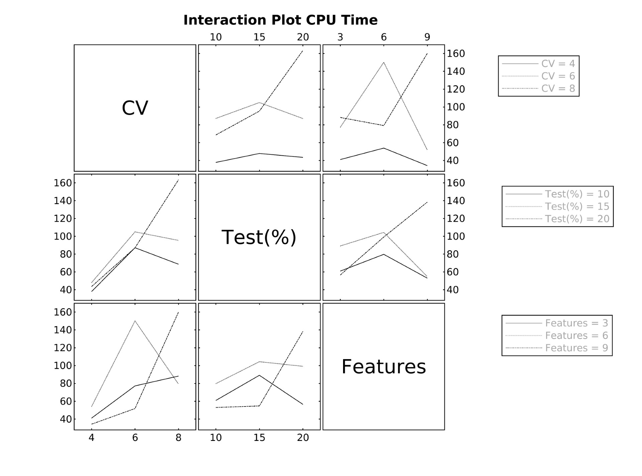
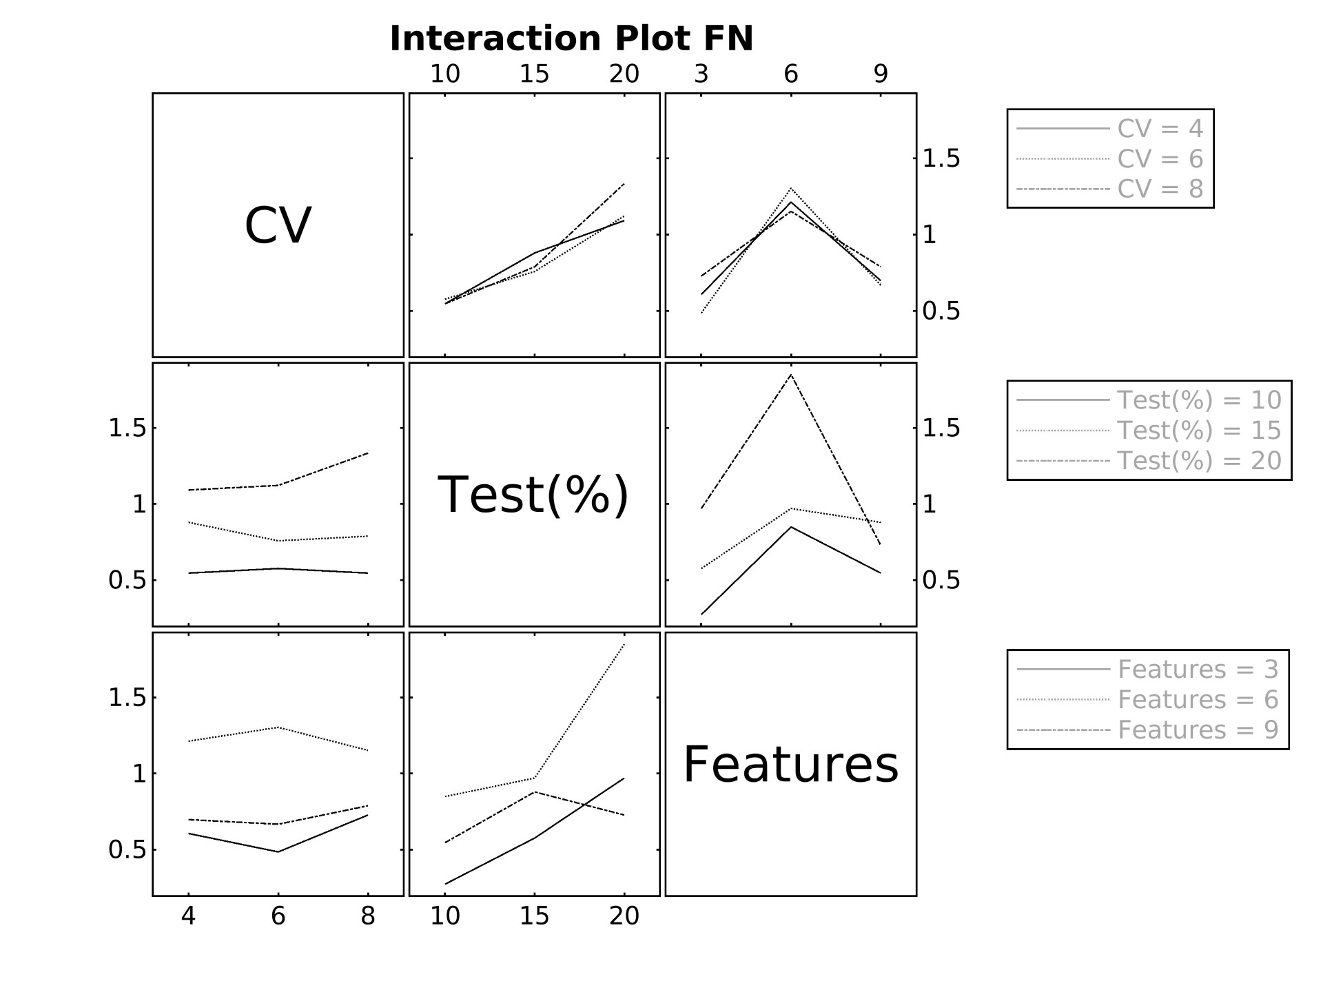
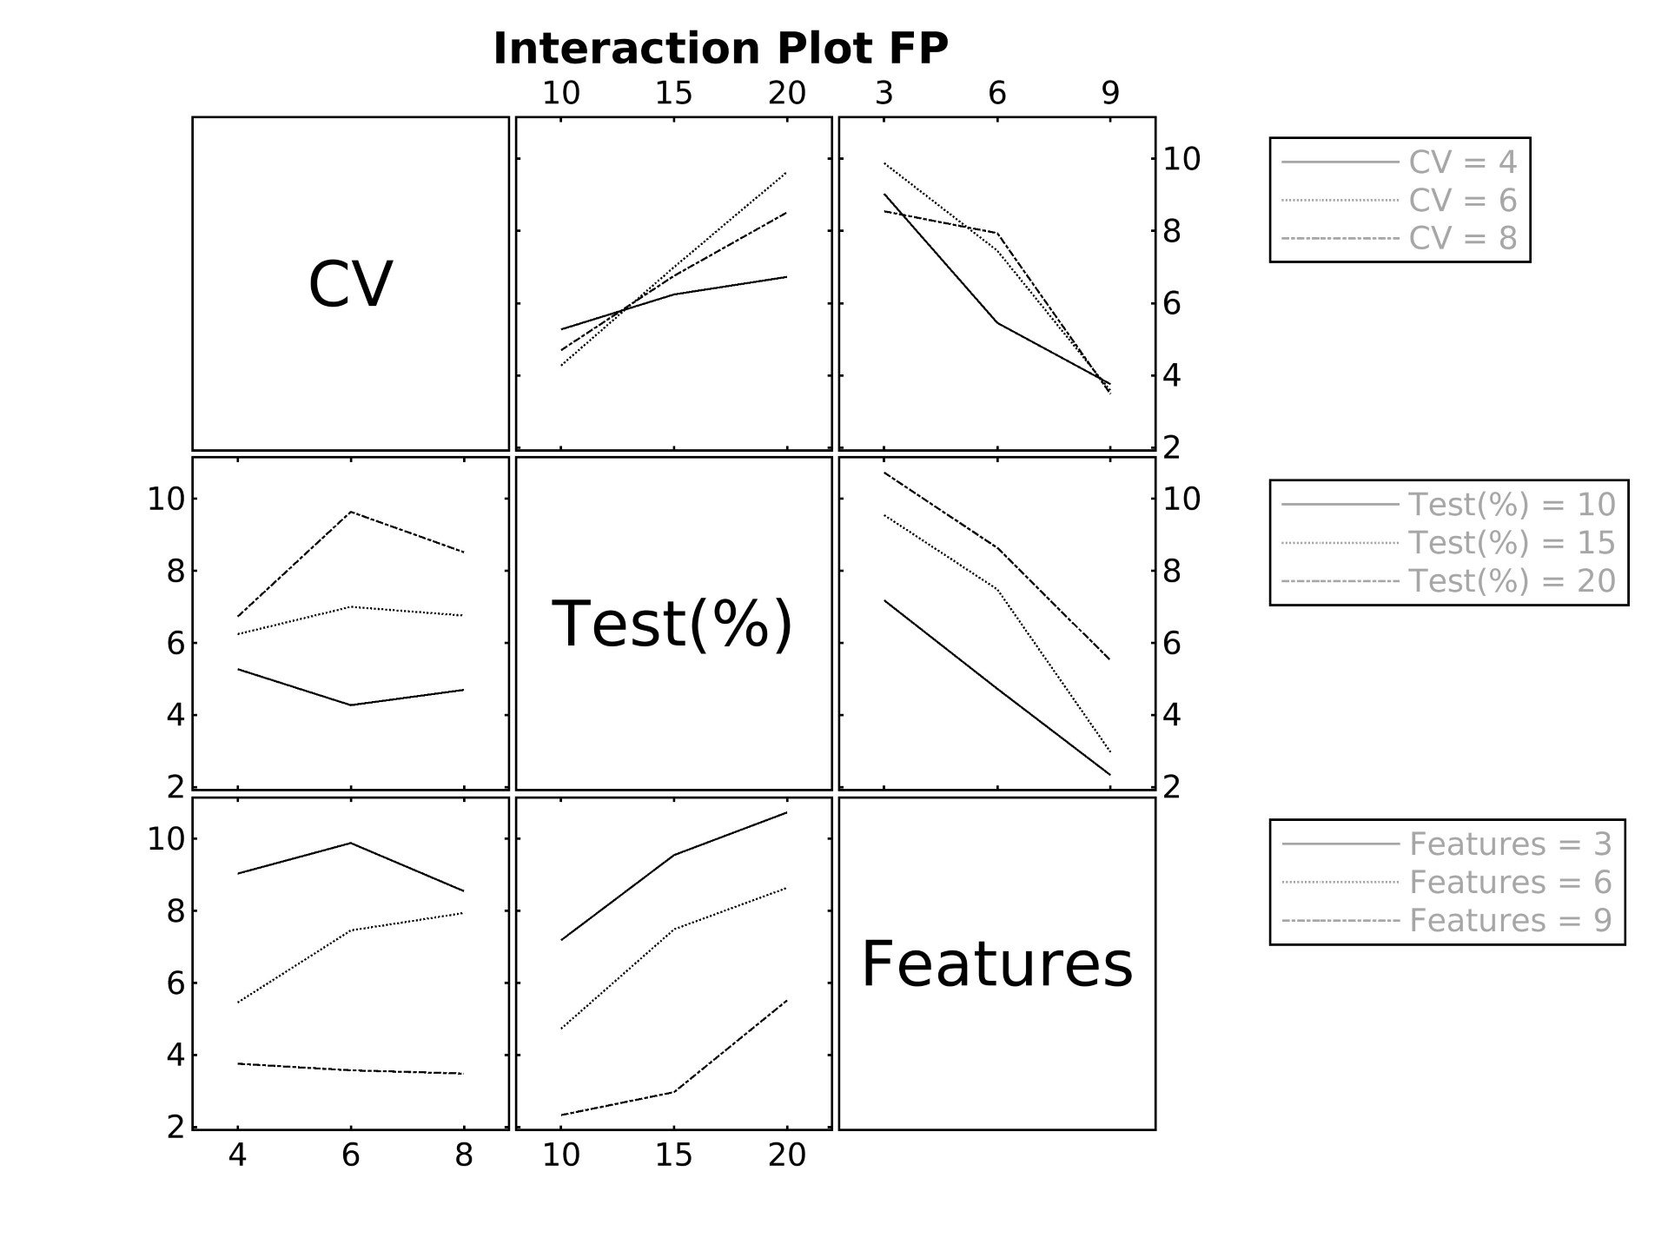
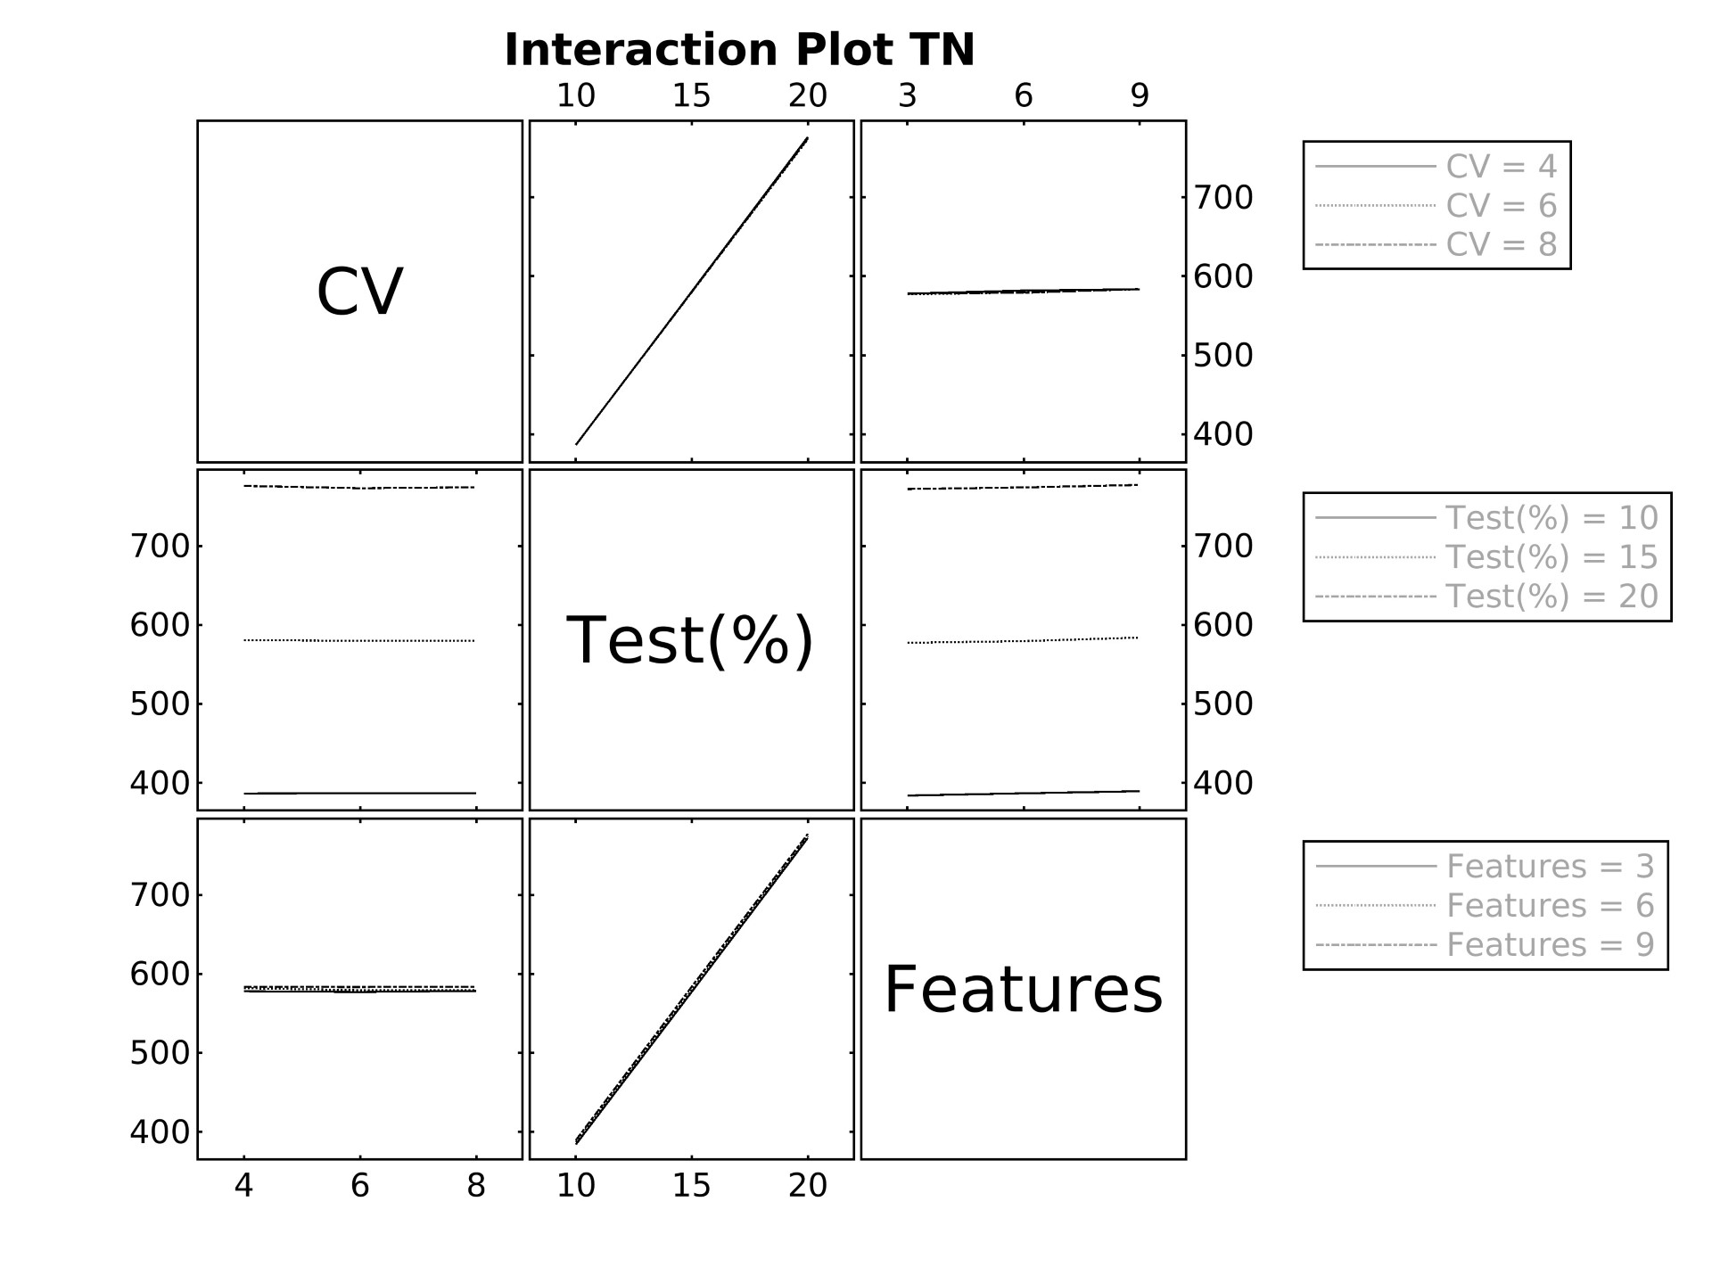
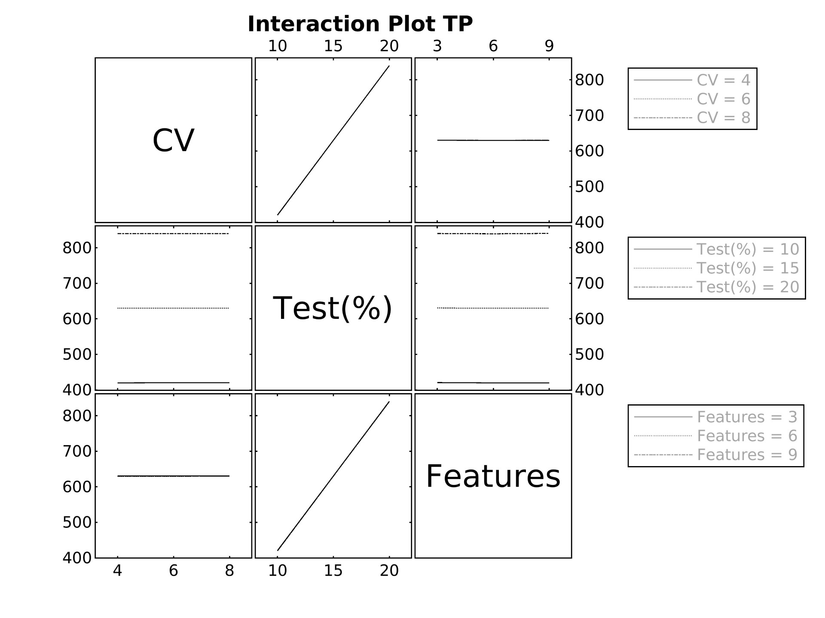
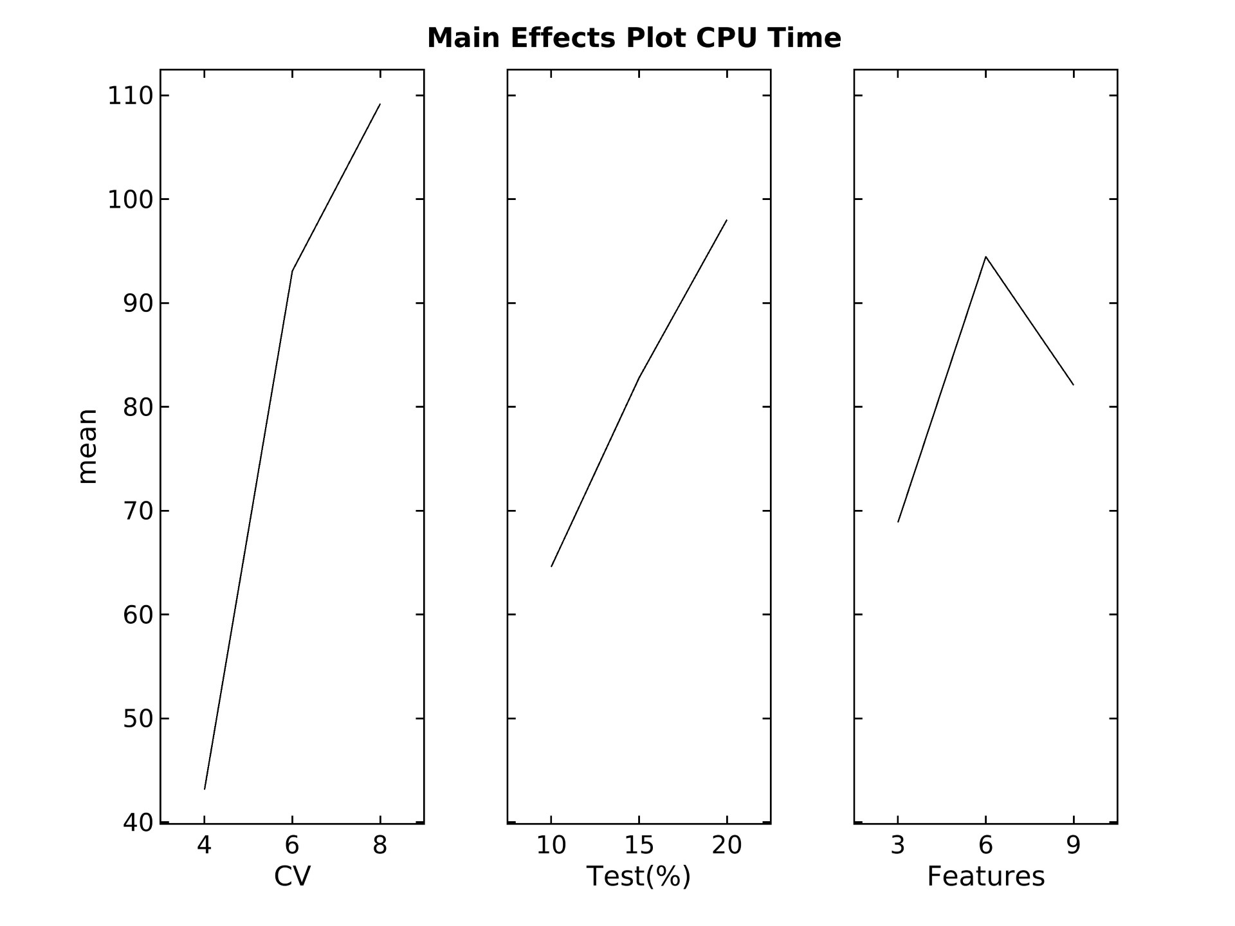
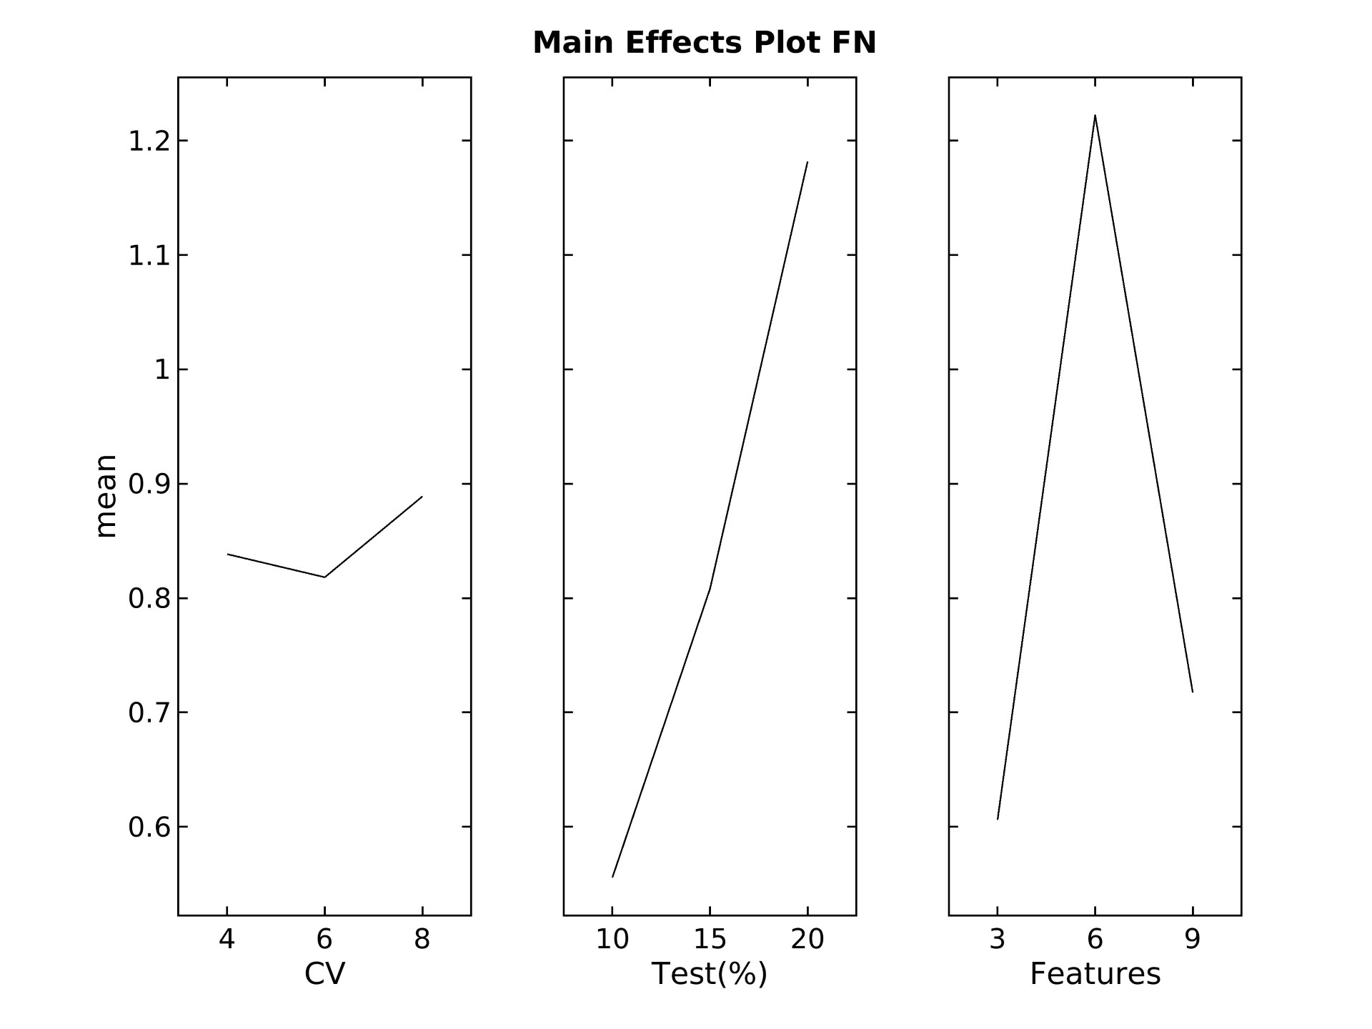
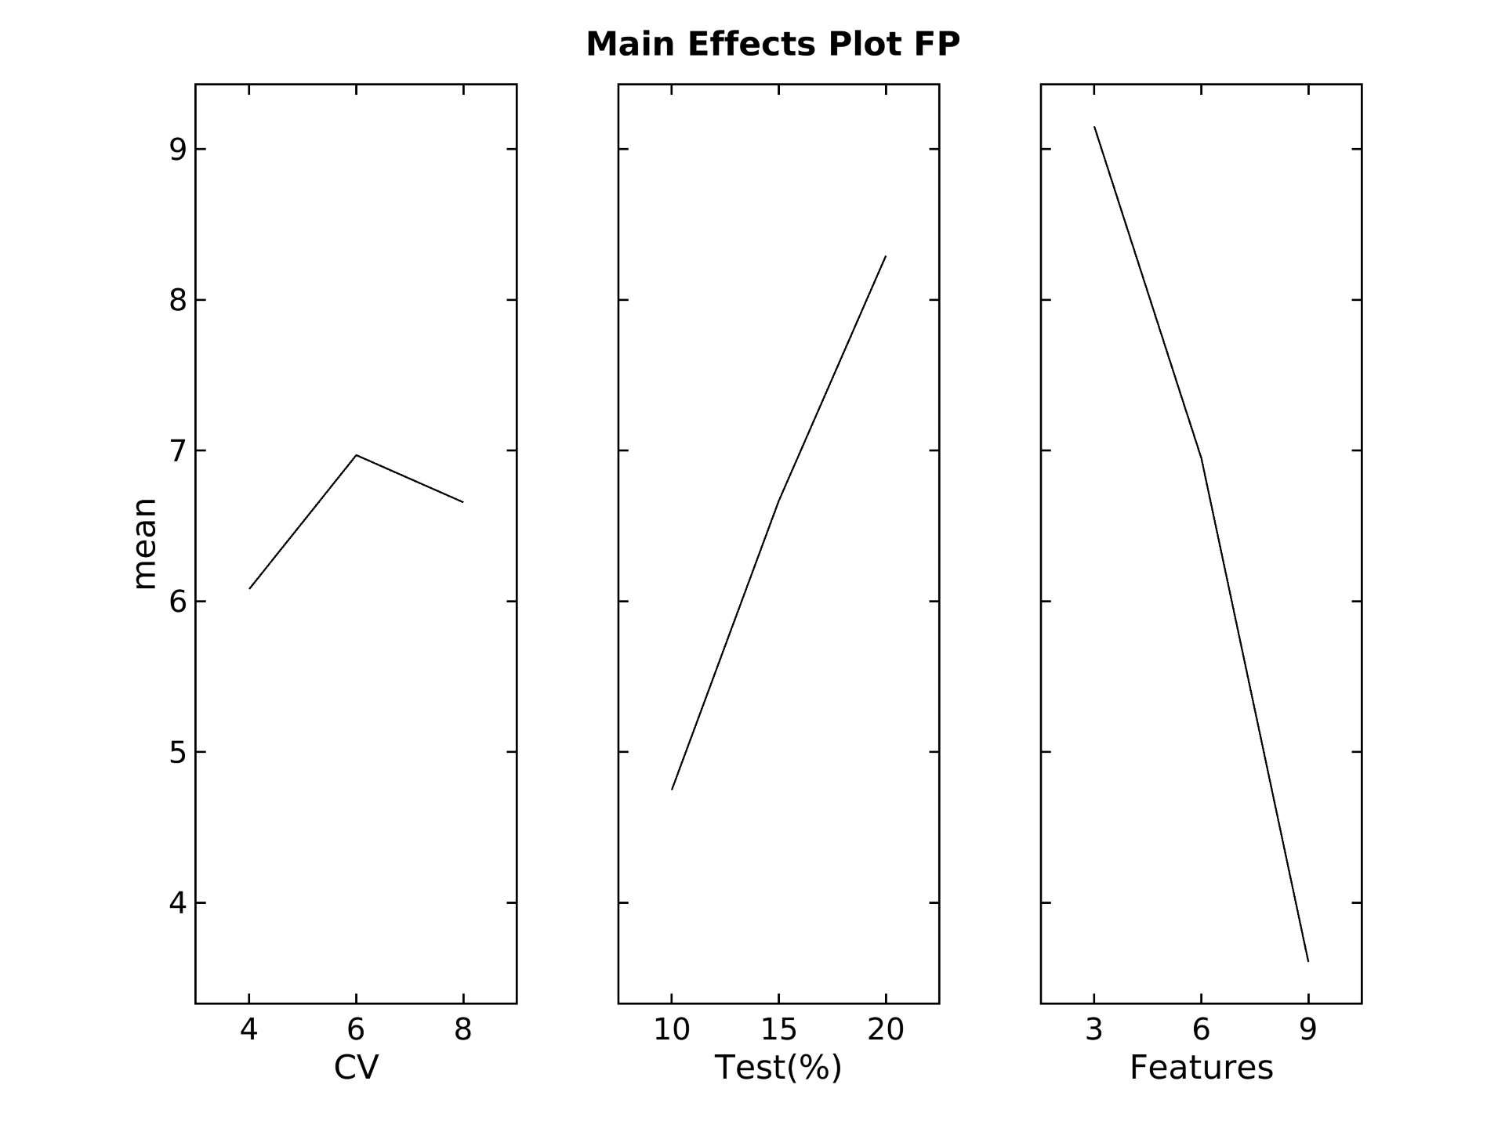
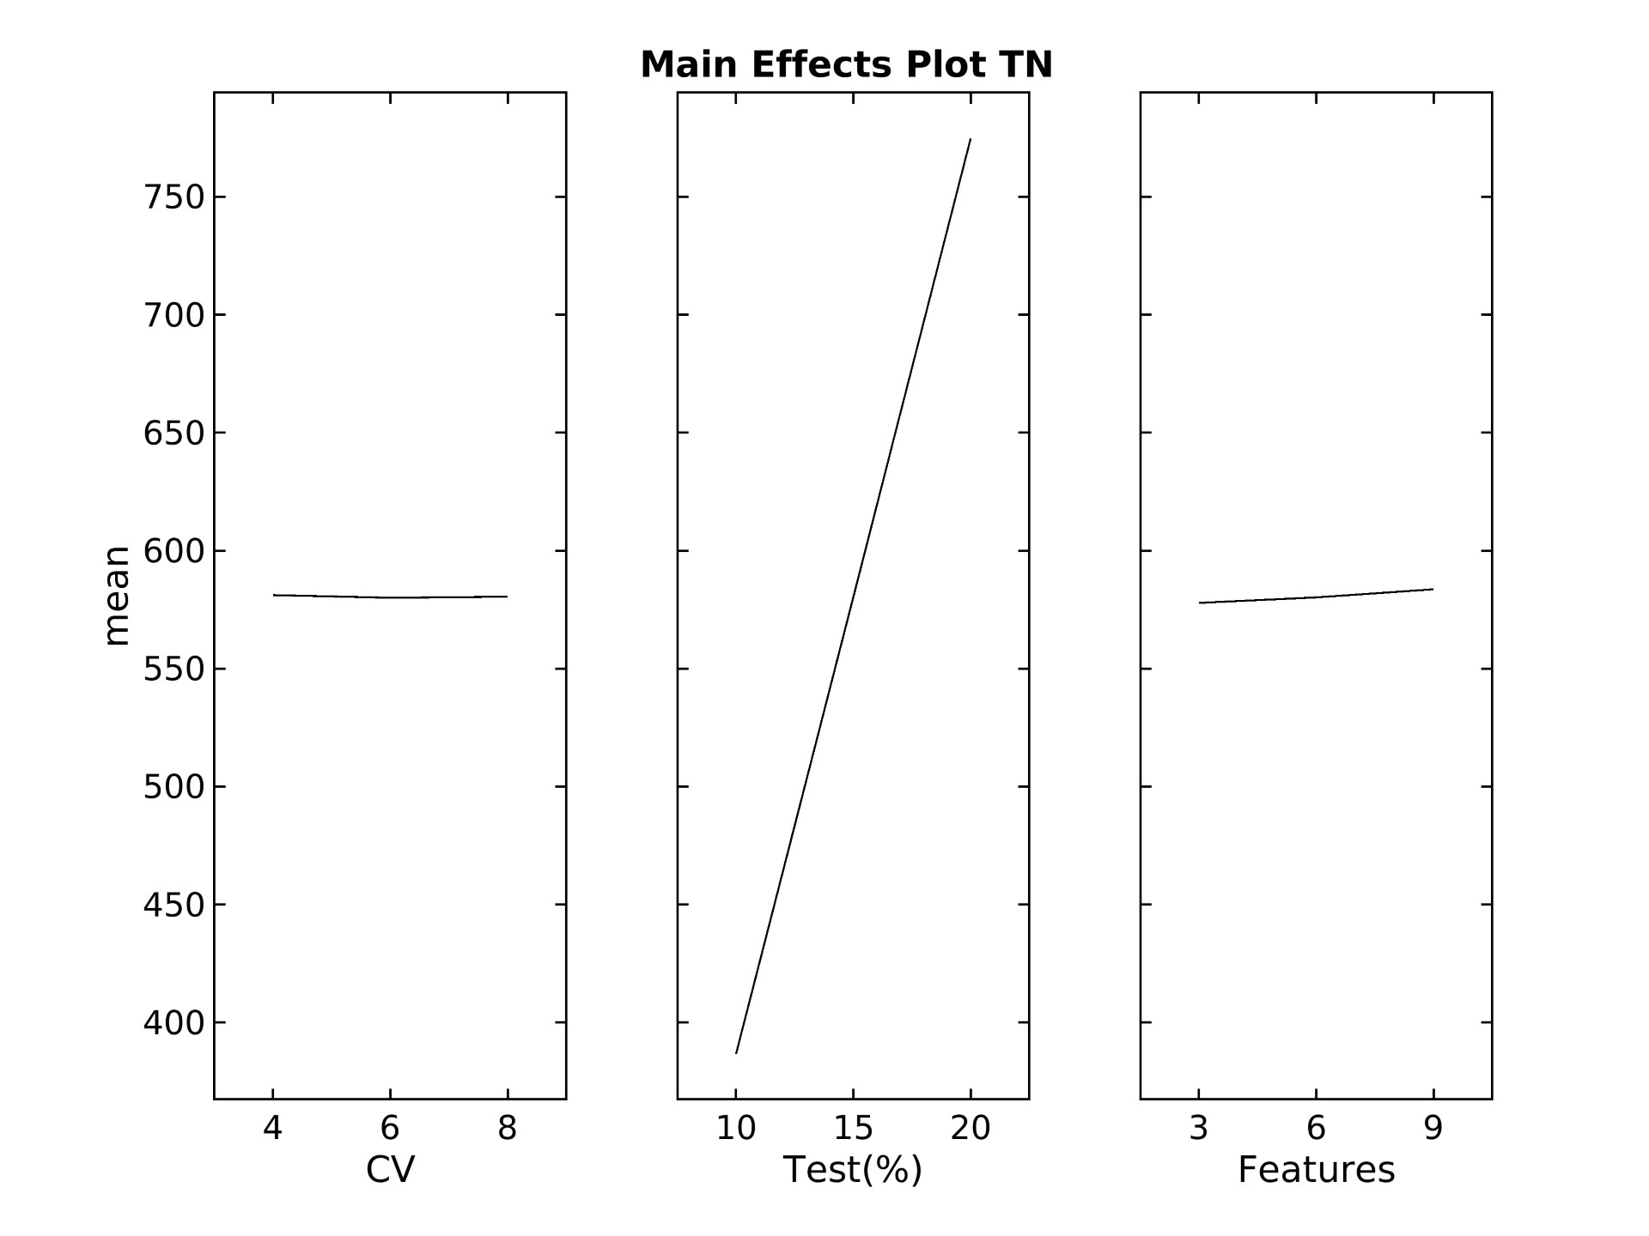
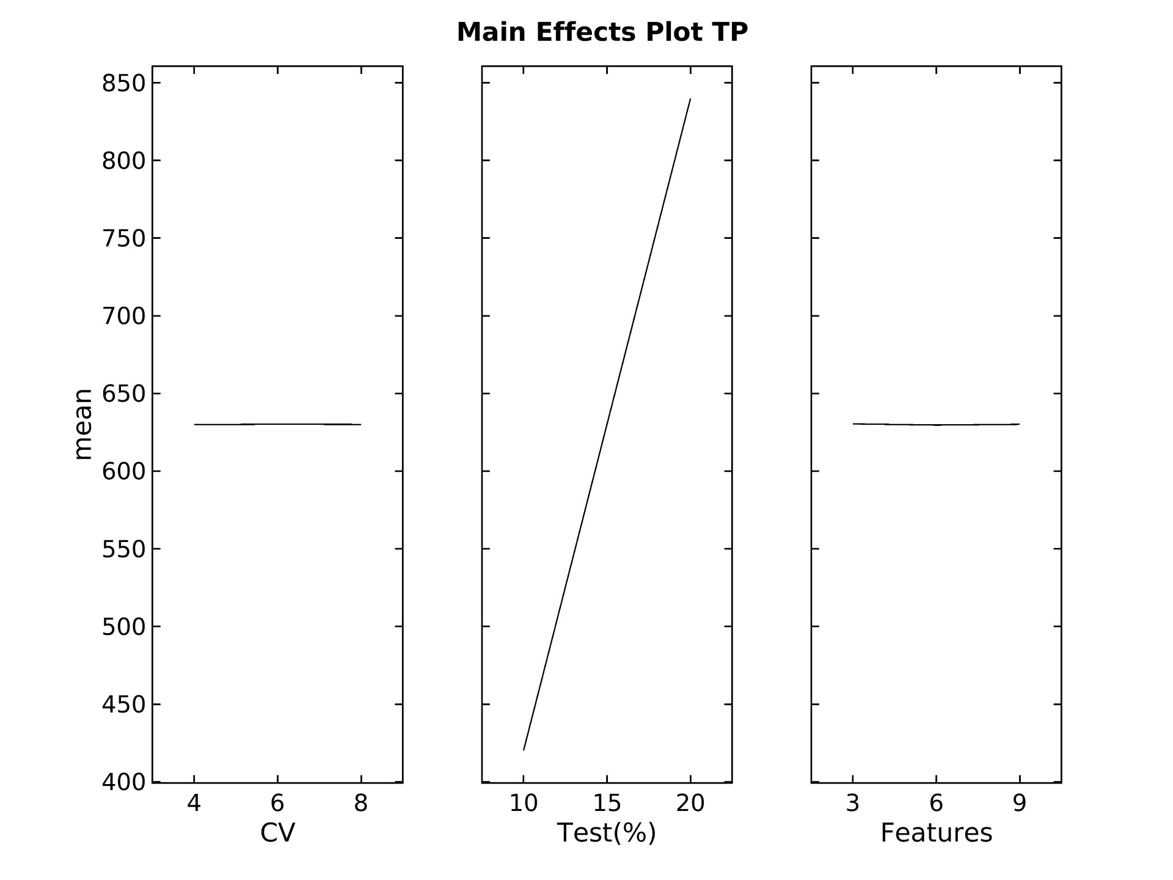
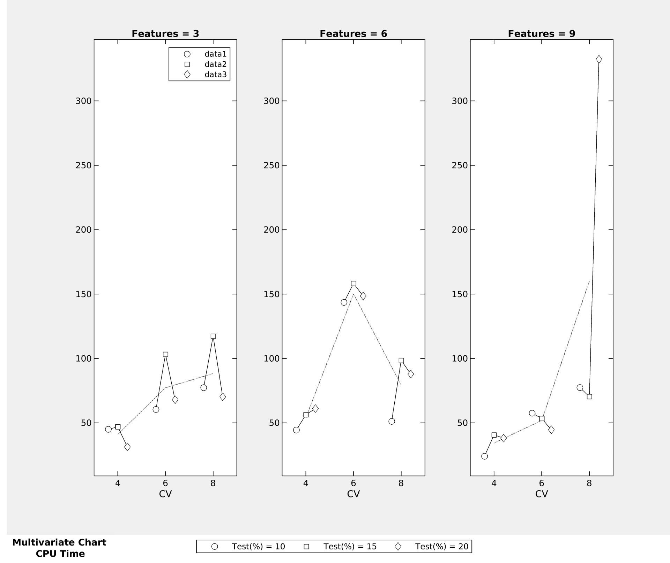
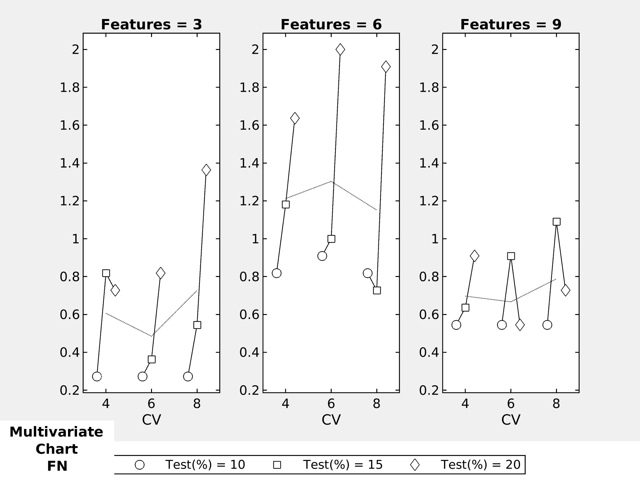
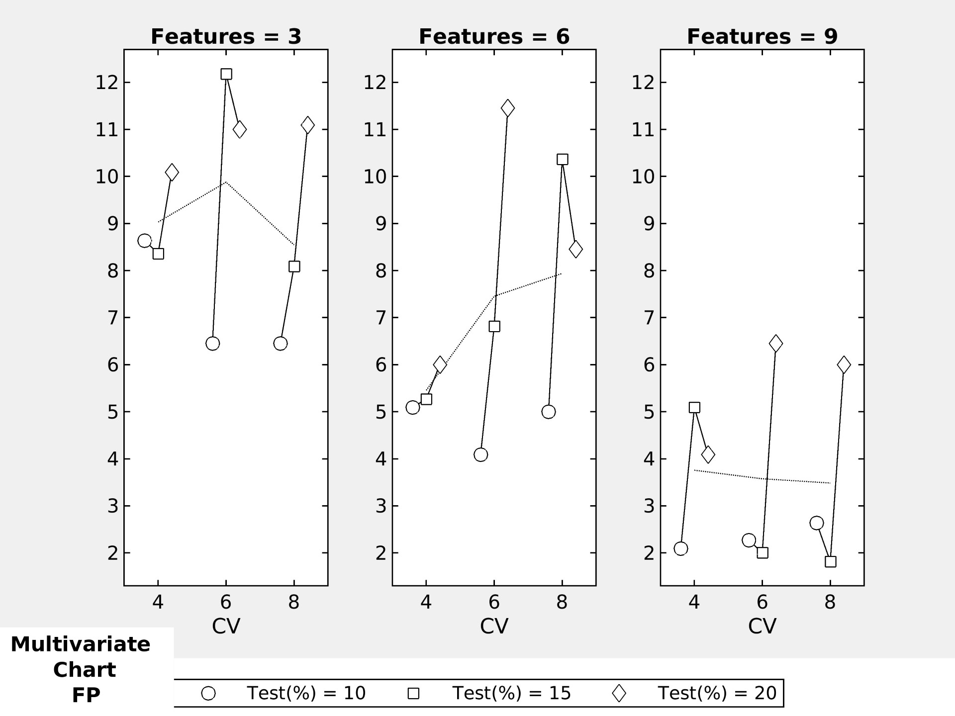
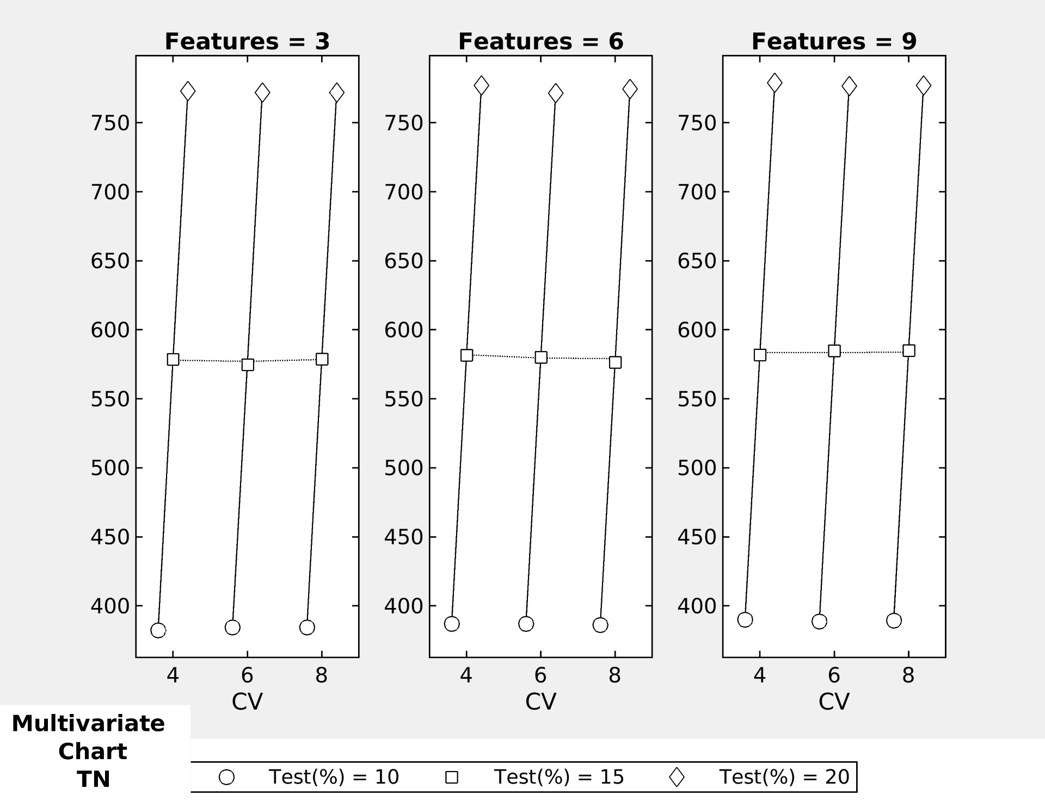
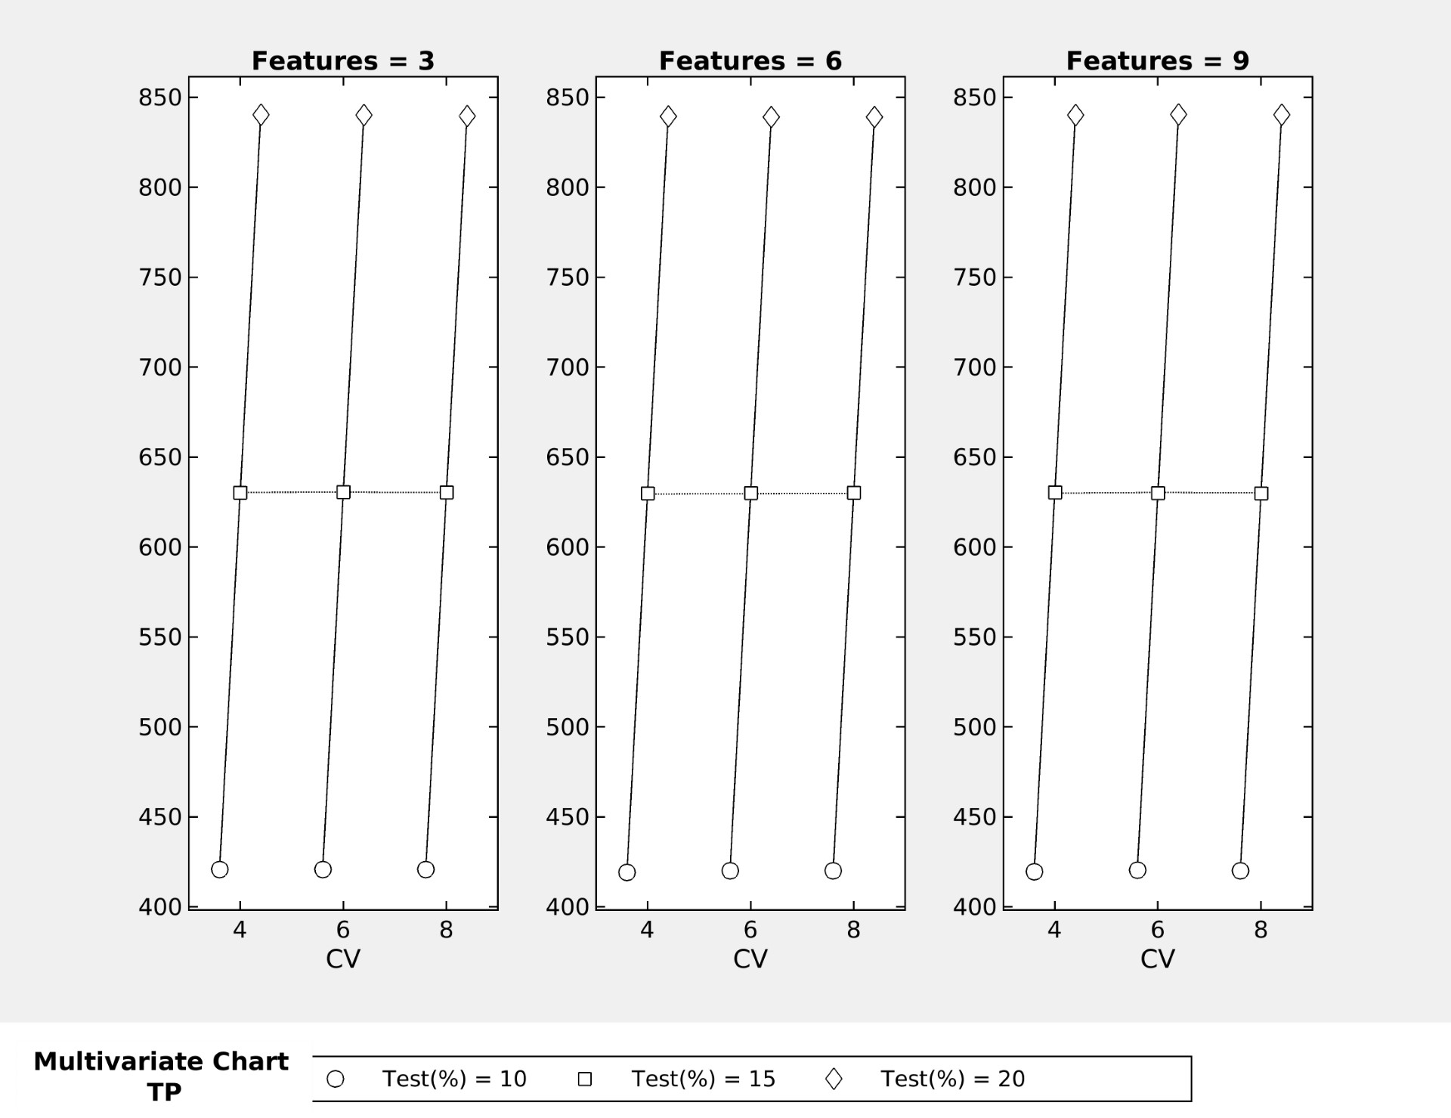
MIN CPU time: 4 CV, Test 10%, 9 features
MIN FN: 6 CV 6, Test 10%, 3 features
MIN FP: Test 10%, 9 features
MAX TN: Test size 20%
MAX TP: Test size 20%
RESULT ANALYSIS

Slide 13
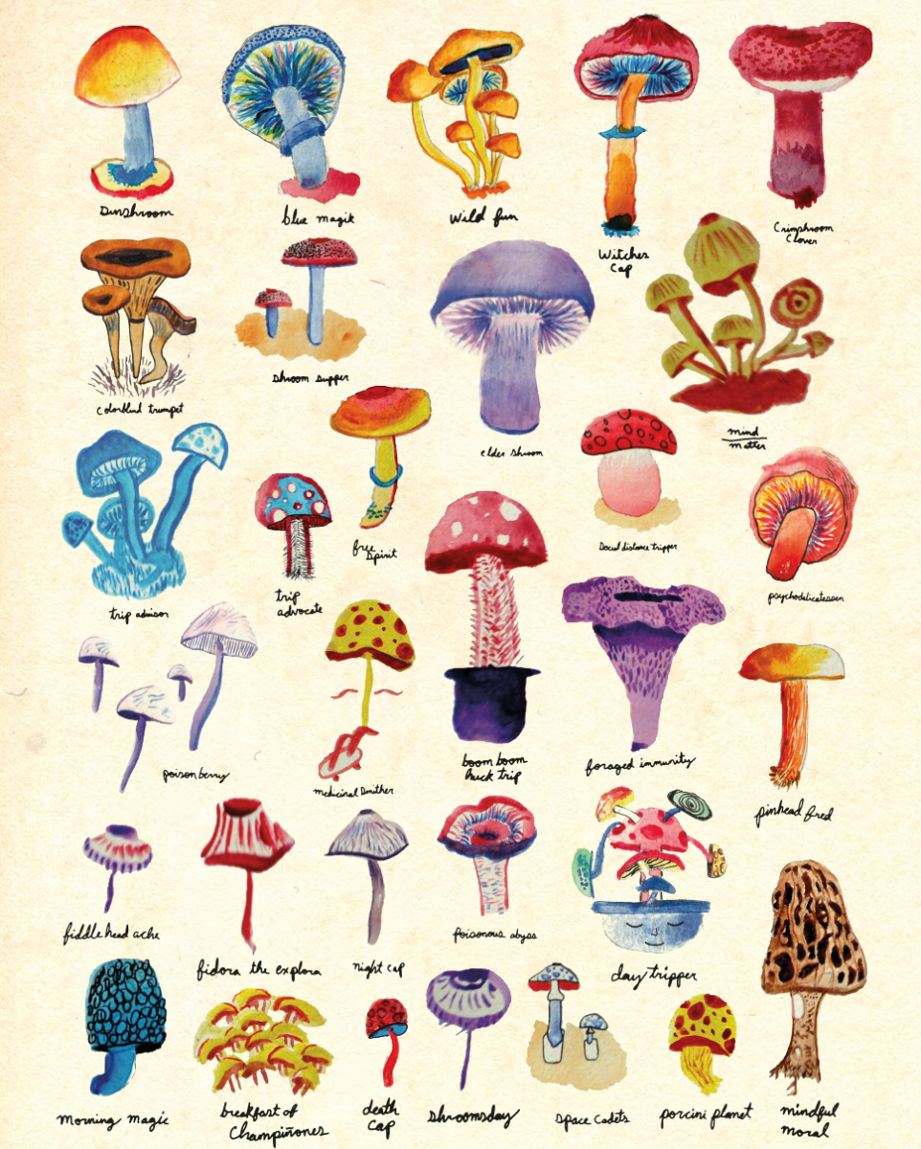
Conclusion
Set 1 (CV 4) has best accuracy
Top Performing ML Methods are Logistic Regression as time < 10 sec (Binary LR, Efficient LR, LR Kernel)
Intriguing Optimizable Naïve Bayes results for further research
Different combinations can affect values of top computing criteria. False Negative is the most important criteria and FN is min at 6 CV, 10% Test Size, 3 features

Slide 14
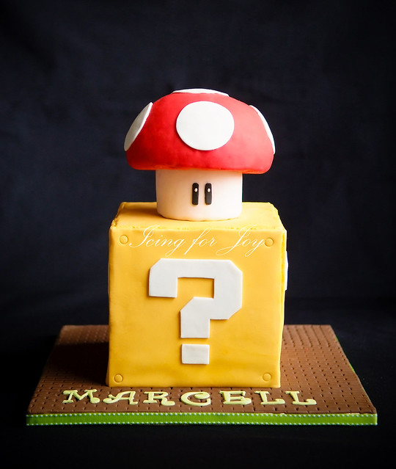
Questions

